Slide 1
سلسلة 3000 كلمة شائعة في اللغة الانكليزية مع مثال
محاضرة 8

Slide 2

Clarify
The teacher tried to clarify the solution

Slide 3

Negotiate
We will have a meeting to negotiate the contract.

Slide 4
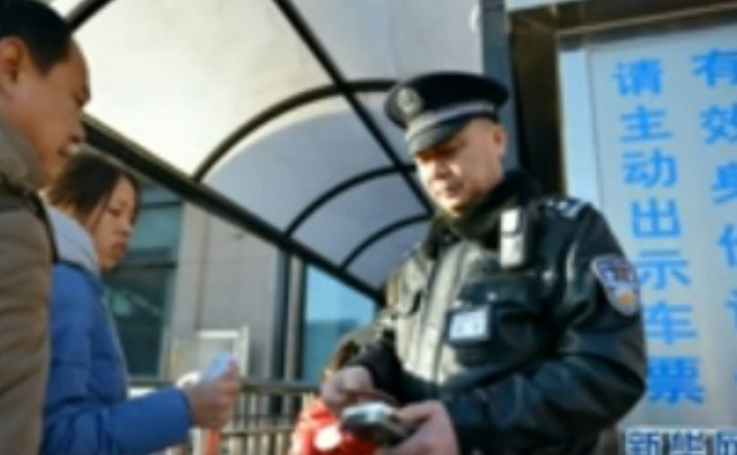
Verify
The police has asked to verify our IDs.

Slide 5

Adventure
Hiking the mountains was a great adventure.

Slide 6
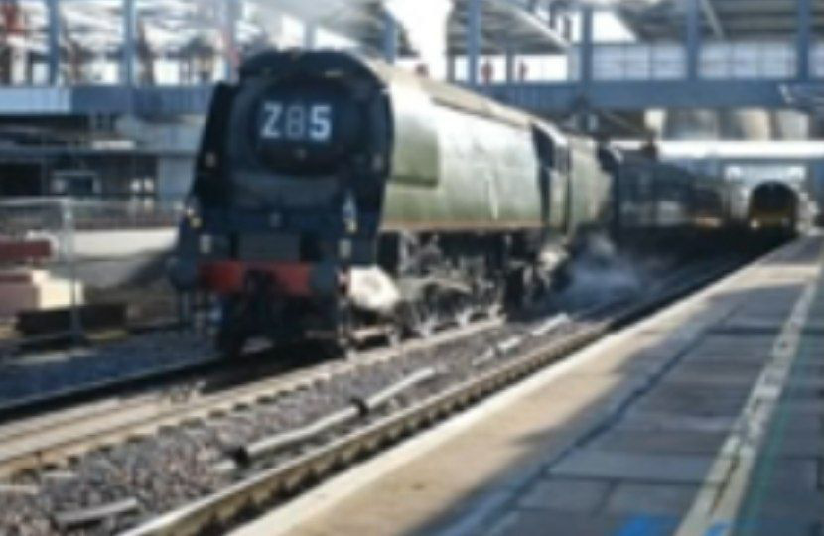
Approach
The train approached the main line.

Slide 7

Carefully
Please drive carefully.

Slide 8
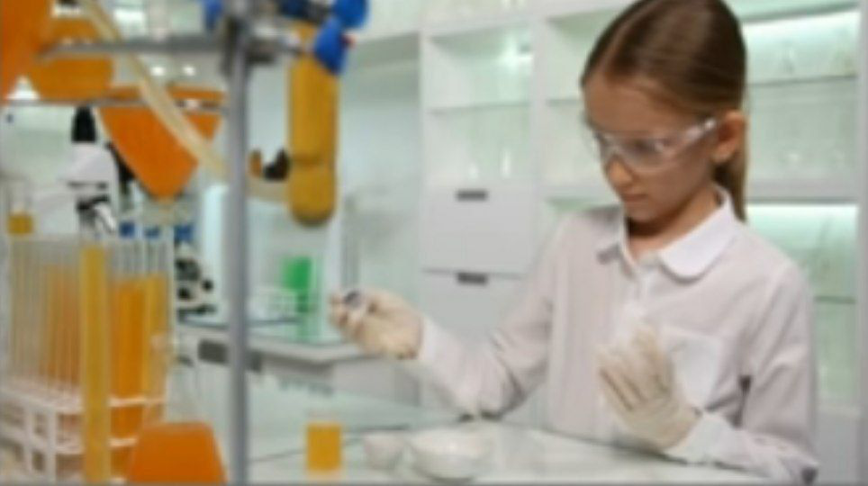
Experiment
The student did an experiment in chemistry class.

Slide 9
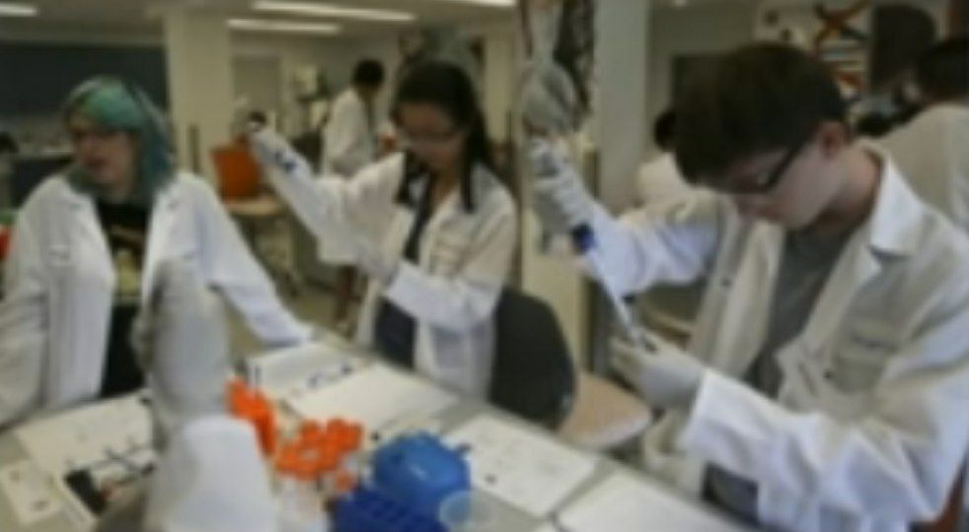
Laboratory
My brother works in a laboratory.

Slide 10

Project
I’m working on my graduation project.

Slide 11

Secret
My brother and I we share a secret.

Slide 12

Terrible
He treated his wife in a terrible way.

Slide 13

Worse
Today, the weather is worse then yesterday.

Slide 14

Among
There is one red box among the green ones.

Slide 15

Chart
We showed the results in chart.

Slide 16


